Slide 1
Maternal and Child Mortality in the United States: Findings from the GBD 2013 Study
Nicholas J Kassebaum, MD
Assistant Professor

Slide 2
Outline
General themes of the Global Burden of Disease (GBD) project
Maternal mortality and progress toward Millennium Development Goal (MDG) 5
Maternal mortality in the United States
Child mortality in the United States

Slide 3
Getting the big picture right
Roadmap of what are the biggest causes of death and functional impairment critical to setting the research agenda, informing priorities for concerted global and national public action and to identifying what works and what does not at the population level.
Huge volume of epidemiological studies using different outcome measures and different methods often do not allow for a coherent picture of what are the most important health problems.
Information provided to decision-makers and the public by advocacy groups can lead to a distorted set perceived priorities. (e.g everyone dies three times)

Slide 4
Global Burden of Disease
A systematic, scientific effort to quantify the comparative magnitude of health loss from all major diseases, injuries, and risk factors by age, sex, and population and over time.
188 countries from 1990 to present. Sub-national assessments for some countries.
GBD 2013 (China, Mexico, UK)
GBD 2015 (+USA, Brazil, Japan, Sweden, Saudi Arabia, Kenya, S Africa)
306 diseases and injuries, 2,337 sequelae, 79 risk factors or clusters of risk factors.
Facilitates direct comparisons across geography, time, age, sex, and cause
Updated annually; release planned for September each year.
Findings published in major medical journals (Science, The Lancet, JAMA, New England Journal of Medicine, PLOS Medicine), policy reports, and online data visualizations.

Slide 5
Where do the data come from?
Government sources: vital statistics, household surveys, censuses, health service administrative data.
Published studies in the medical literature – systematic reviews of published data.
Other household surveys and studies conducted by international organizations and other groups e.g., DHS, MICS, LSMS.
All data sources used in the GBD for a country are catalogued in the Global Health Data Exchange (GHDx) available online at http://ghdx.healthdata.org

Slide 6
GBD: a global study with a global network
1,321 collaborators from 114 countries as of Dec 2015

Slide 7
DALYs = YLL + YLD
DALY = Disability-adjusted life year
YLL = Year of life lost (mortality)
YLD = Year of life lived with disability (non-fatal sequelae)

Slide 8
YLL = # of deaths at age x
x Standard life expectancy at age x

Slide 9
YLD_{sequela} = Prevalence_{sequela}
x Disability Weight_{health state}

Slide 10
Outline
General themes of the Global Burden of Disease (GBD) project
Maternal mortality and progress toward Millennium Development Goal (MDG) 5
Maternal mortality in the United States
Child mortality in the United States

Slide 11
Millennium development goals
A series of eight time bound targets, with a deadline of 2015, aimed at committing nations to a new global partnership to reduce extreme poverty
MDG 5 has an explicit goal of reducing maternal mortality by 75% between 1990 and 2015
The GBD framework is comprehensive and internally consistent. It is optimally suited to track health progress

Slide 12
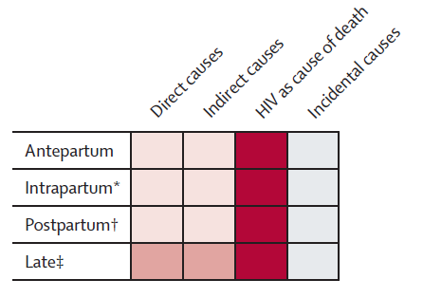
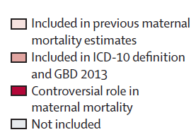
Definition of a “maternal” death
Not all deaths that occur during pregnancy are “maternal.” Pregnancy needs to be a causal factor.
Direct causes are the result of complications of pregnancy, childbirth, or postpartum events
Indirect causes are those where pregnancy has exacerbated a pre-existing condition
In 1994 with ICD-10, the time period for maternal deaths was extended from 6 weeks postpartum to one year postpartum. This category is known as late maternal mortality.

Slide 13
Estimating maternal mortality in 6 steps
1
2
Collect and process all maternal mortality data. Adjust for bias, misclassification and underreporting. Exclude incidental deaths
Develop model to estimate "proportion maternal" (PM) of all deaths in women in the age range of 10-49 years
3
4
Calculate “total maternal deaths“
by multiplying PM against the total number of all-cause deaths
Correct for incidental HIV-related deaths.
5
6
CODCorrect: Ensures the
sum of all cause-specific deaths = the total # of all-cause deaths
Compute “maternal mortality ratio“
by dividing total deaths by total live births for each age, country, year

Slide 14
Data Collection and processing
The final GBD 2013 dataset included
73 site years of censuses,
267 site years of verbal autopsy,
626 site years of surveillance,
1213 site years of sibling histories from health surveys (e.g. DHS, RHS)
4877 site years of vital registration and sample registration
7056 total site-years
180 of 188 countries represented

Slide 15
All data sources were subject to standard algorithms to adjust for known biases
Examples
Sibling history data corrected for survivor bias
Vital registration data: misclassification and garbage/ non-specific codes were addressed via statistical redistribution algorithms
Stochastic variability and upward bias from zero counts addressed with Bayesian noise reduction algorithms
Misclassification example: Fraction of all deaths assigned to non-specific causes in Greece by year in females ages 15-49.

Slide 16
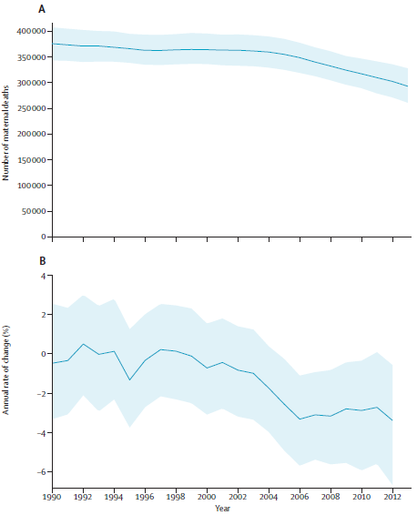
Maternal mortality globally
Global deaths in 1990 were 376,034 (343,483 to 407,574), then 292,982 (261,017 to 327,792) in 2013.
Over 99% of all maternal deaths are in developing countries.
Global MMR decreased from 283.2 (258.6 to 306.9) in 1990 to 209.1 (186.3 to 233.9) in 2013.
Annual rate of change was -1.3% (-1.9 to -0.8) over this time.
This is well shy of the -5.5% annual change needed to achieve MDG5, though there is evidence of recent acceleration.
-5.5% = MDG5 achievement rate

Slide 17
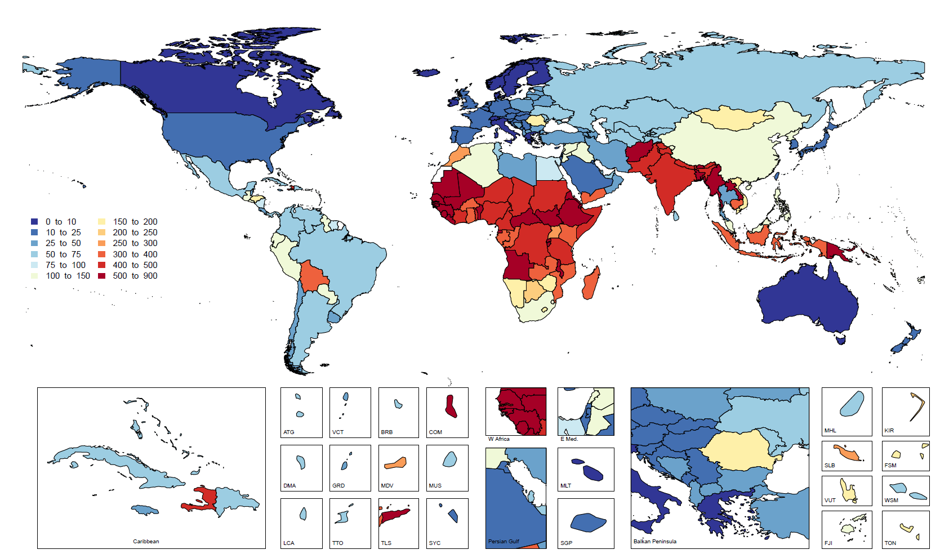
Maternal Mortality Ratio in 1990

Slide 18
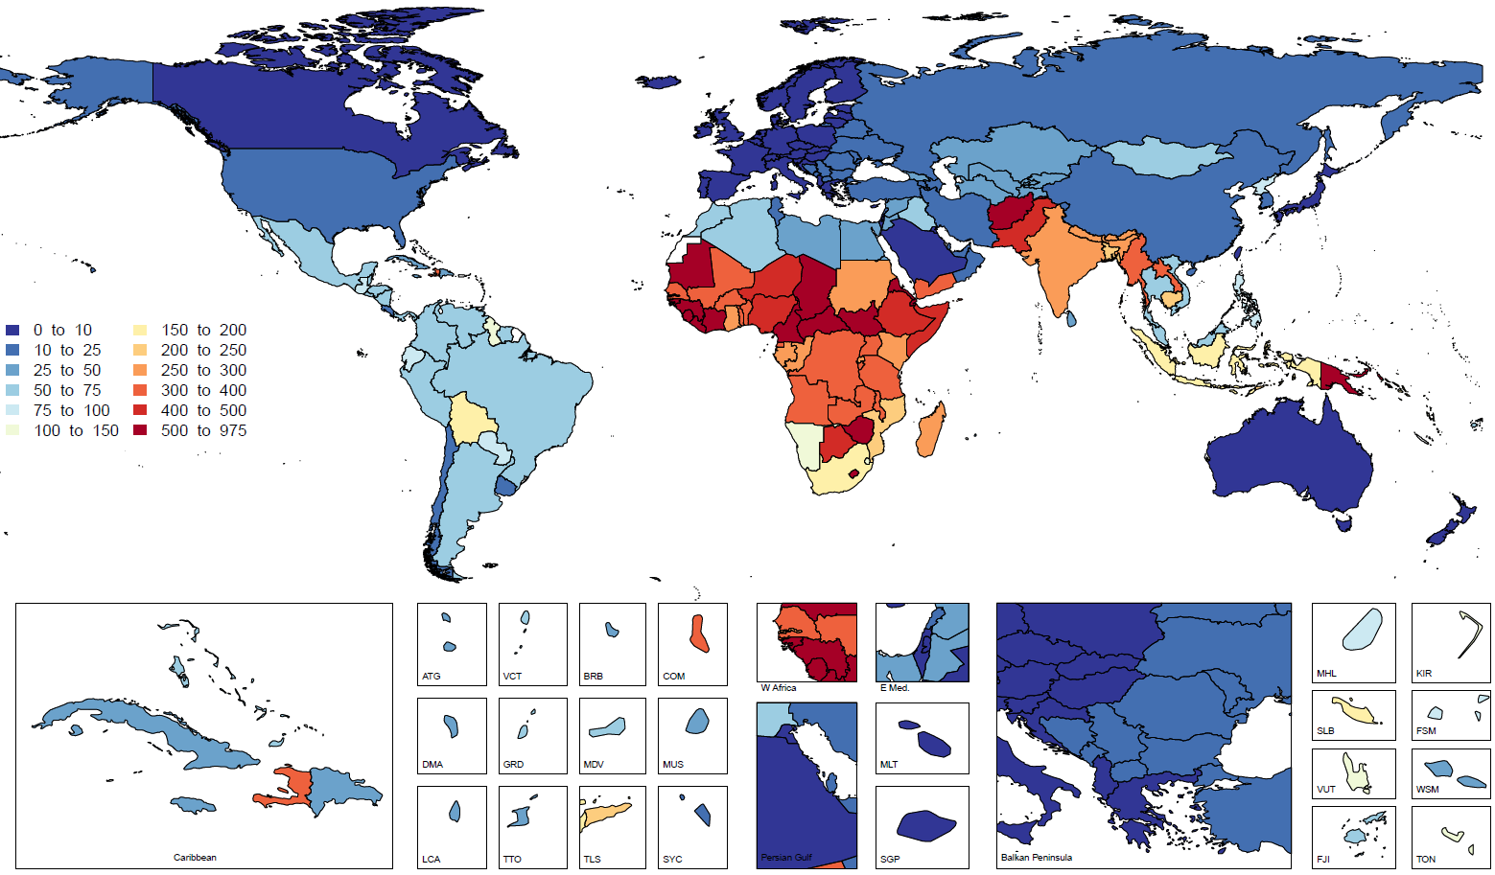
Maternal Mortality Ratio in 2013

Slide 19
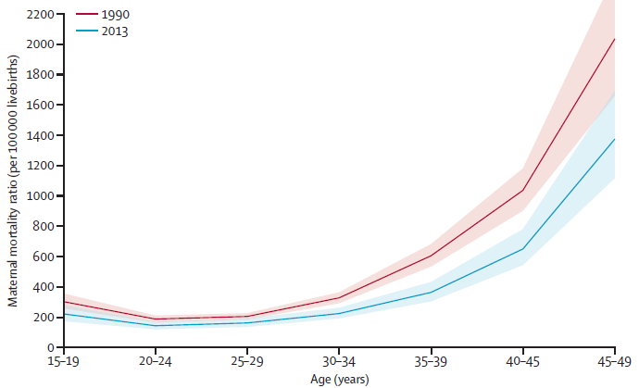
Maternal mortality findings
MMR is highest in the oldest age groups and lowest in women aged 20 to 29. Statistically significant decreases in MMR were seen in all age groups between 1990 and 2013.

Slide 20
Study Conclusions
16 countries will achieve MDG5 (7 are developing. 7/138 = 5.1% of all developing countries).
East, Southeast, and South Asia improved consistently.
MMR in most of sub-Saharan Africa increased in the 1990s before big, accelerating decreases that started after 2000.
Parts of west and central Africa still have very high maternal mortality and need special focus. Countries with high mortality should focus on simple, proven interventions first. Family planning and safe abortion services are essential.
Causes of death globally seem to be shifting from those that respond to simple interventions (e.g. hemorrhage, sepsis, obstructed labor) to those that will require improved health system performance to prevent (direct – medical complications; indirect – NCDs; late – women dying from pregnancy-related complications well after the pregnancy is over.)

Slide 21
Study Conclusions 2: Country comparisons
16 countries had reductions of greater than 5.5% between 1990 and 2013 and appear poised to achieve MDG5:
Albania, United Arab Emirates, Bosnia and Herzegovina, Belarus, China, Estonia, Lebanon, Lithuania, Latvia, Morocco, Maldives, Mongolia, Oman, Poland, Romania, and Russia
In 2013, 16 countries still had MMR greater than 500, suggesting they are being left behind:
Afghanistan, Cameroon, Central African Republic, Chad, Côte d’Ivoire, Djibouti, Eritrea, Guinea, Guinea-Bissau, Liberia, Lesotho, Mauritania, Papua New Guinea, Sierra Leone, South Sudan, and Zimbabwe
Between 2003 and 2013 only eight countries experienced increased MMR:
Afghanistan, Belize, El Salvador, Guinea-Bissau, Greece, Seychelles, South Sudan, and the United States

Slide 22
Outline
General themes of the Global Burden of Disease (GBD) project
Maternal mortality and progress toward Millennium Development Goal (MDG) 5
Maternal mortality in the United States
Child mortality in the United States

Slide 23
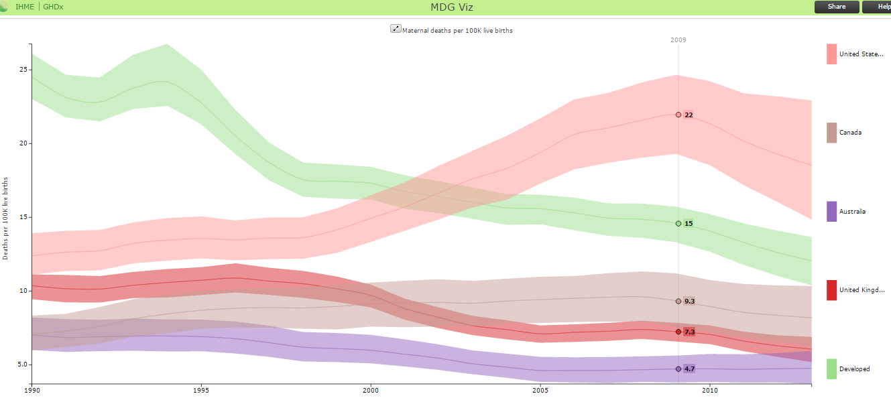
Maternal mortality in USA has increased
Interactive visualizations of all the MDG analyses are available: http://vizhub.healthdata.org/mdg/

Slide 24
Why is maternal mortality in the United States increasing?
Possible explanations:
Statistics are better now
Delayed age of pregnancy
Increasing cesarean section rate
Increasing high-risk pregnancies
Worsening health care coverage/ access

Slide 25
Is it because our statistics are better now?
Support:
ICD-10 added “late maternal death” in 1994. Uptake took time; most states in USA adopted its use in the early 2000s
Most US states now have a pregnancy checkbox on official death certificate; helped reduce missed maternal deaths
Arguments against:
All countries had access to ICD-10 at the same time; >35 have adopted use of late maternal death codes
Few countries have checkbox, but many have completed surveillance/ enquiry studies to find “missed” maternal deaths and used this information to correct official statistics
Even if true, this would mean that maternal mortality has been high in the USA for a long time

Slide 26
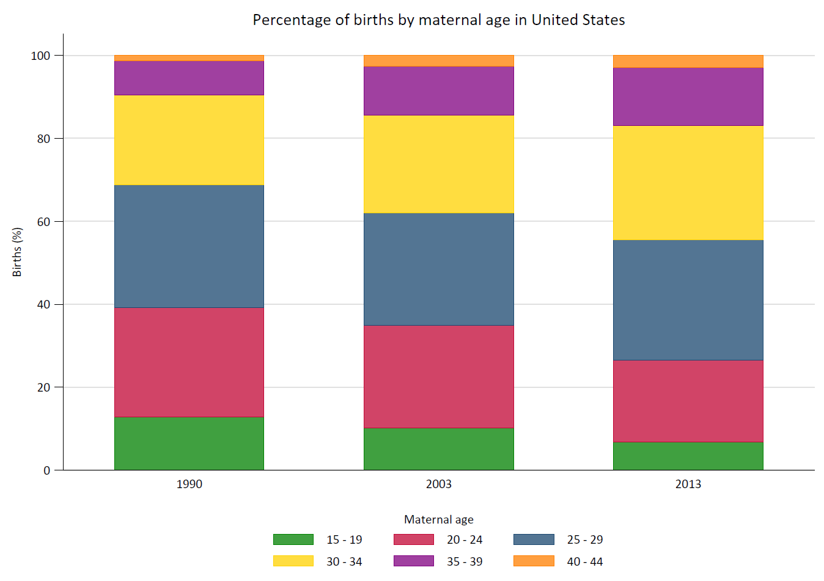
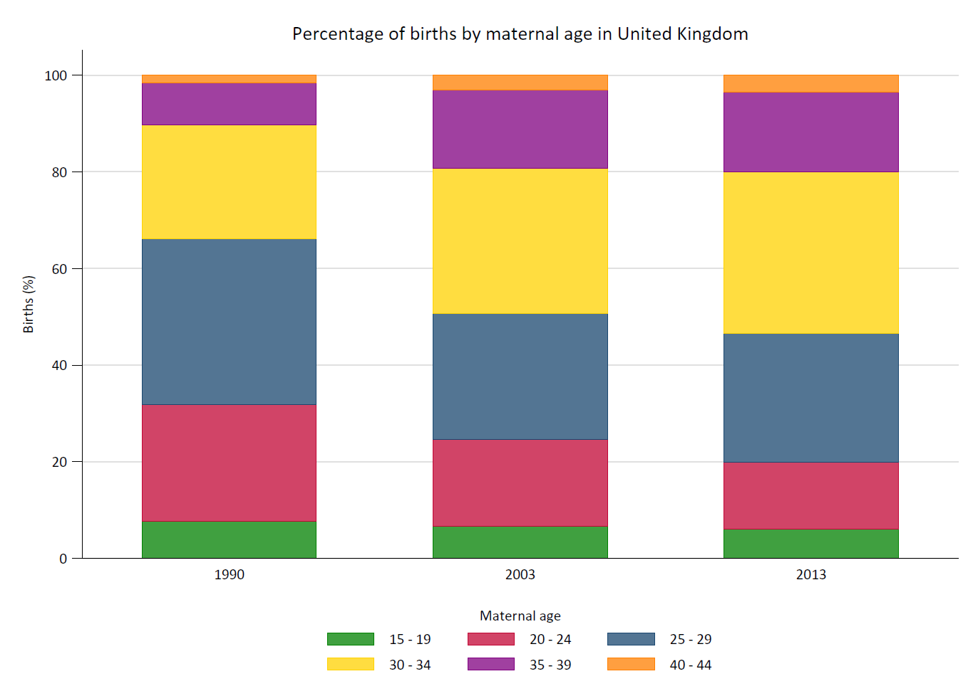
Proportion of births by age of mother in USA (left) and UK (right) from 1990 to 2013

Slide 27
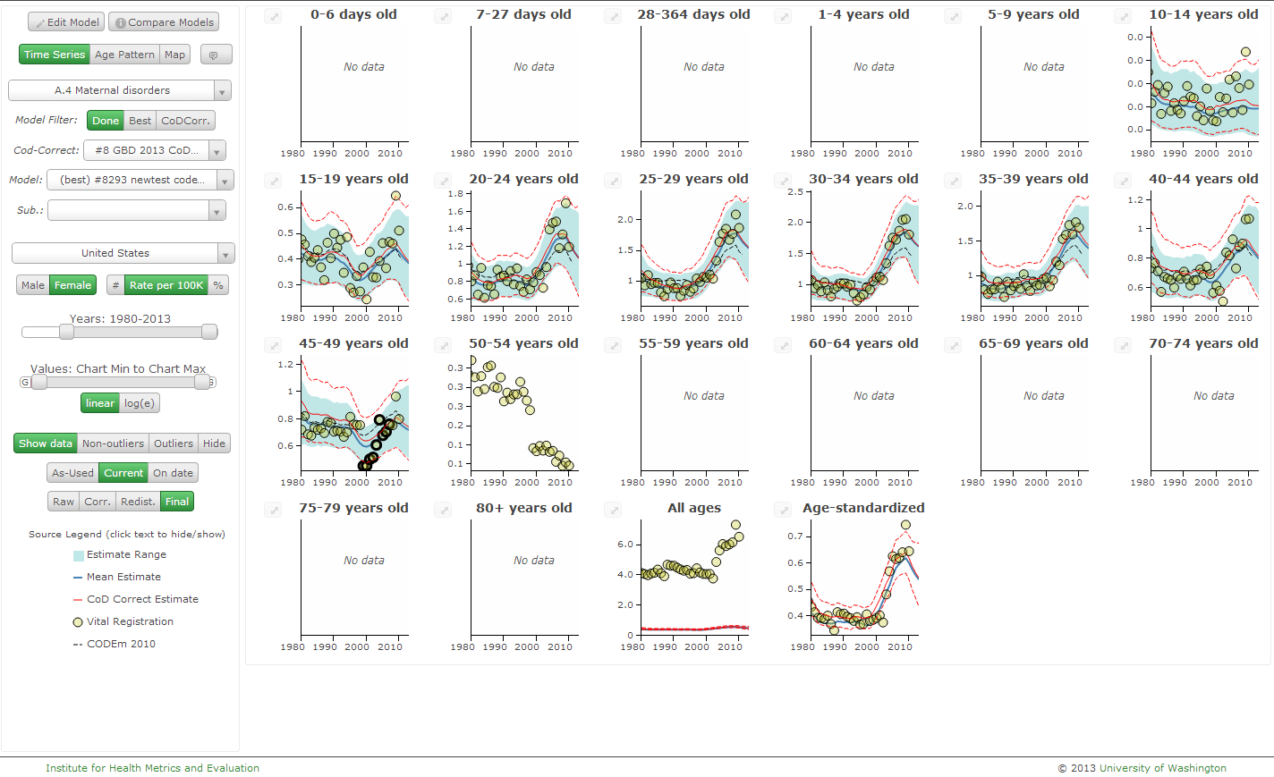
Is it because mothers are older?
Probably not: Despite modestly increasing proportion of births amongst older mothers, increased mortality was seen in all age groups.

Slide 28
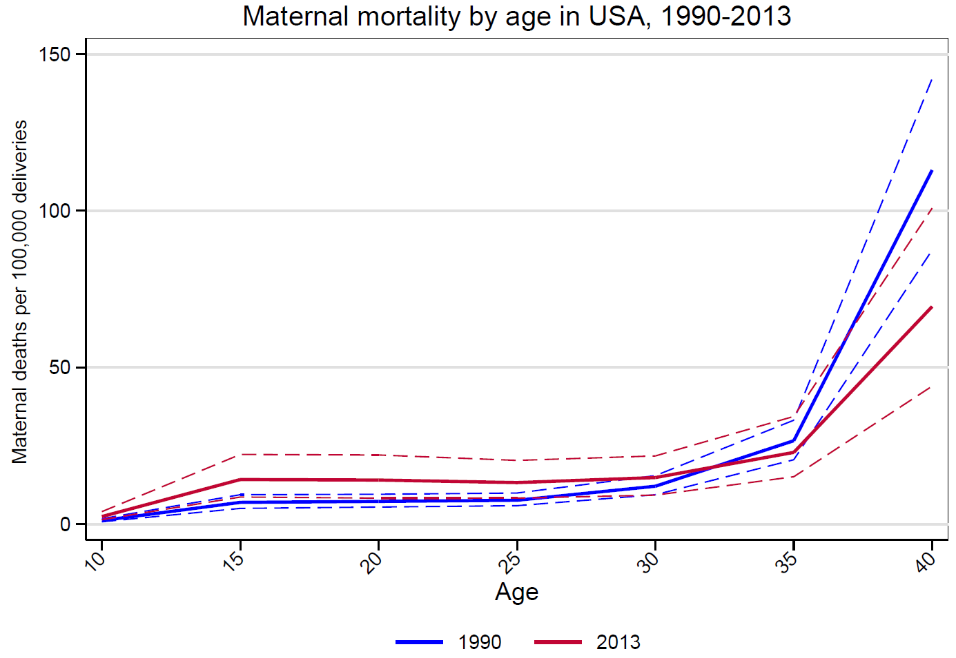
Young women are doing worse, older women are actually doing better than before

Slide 29
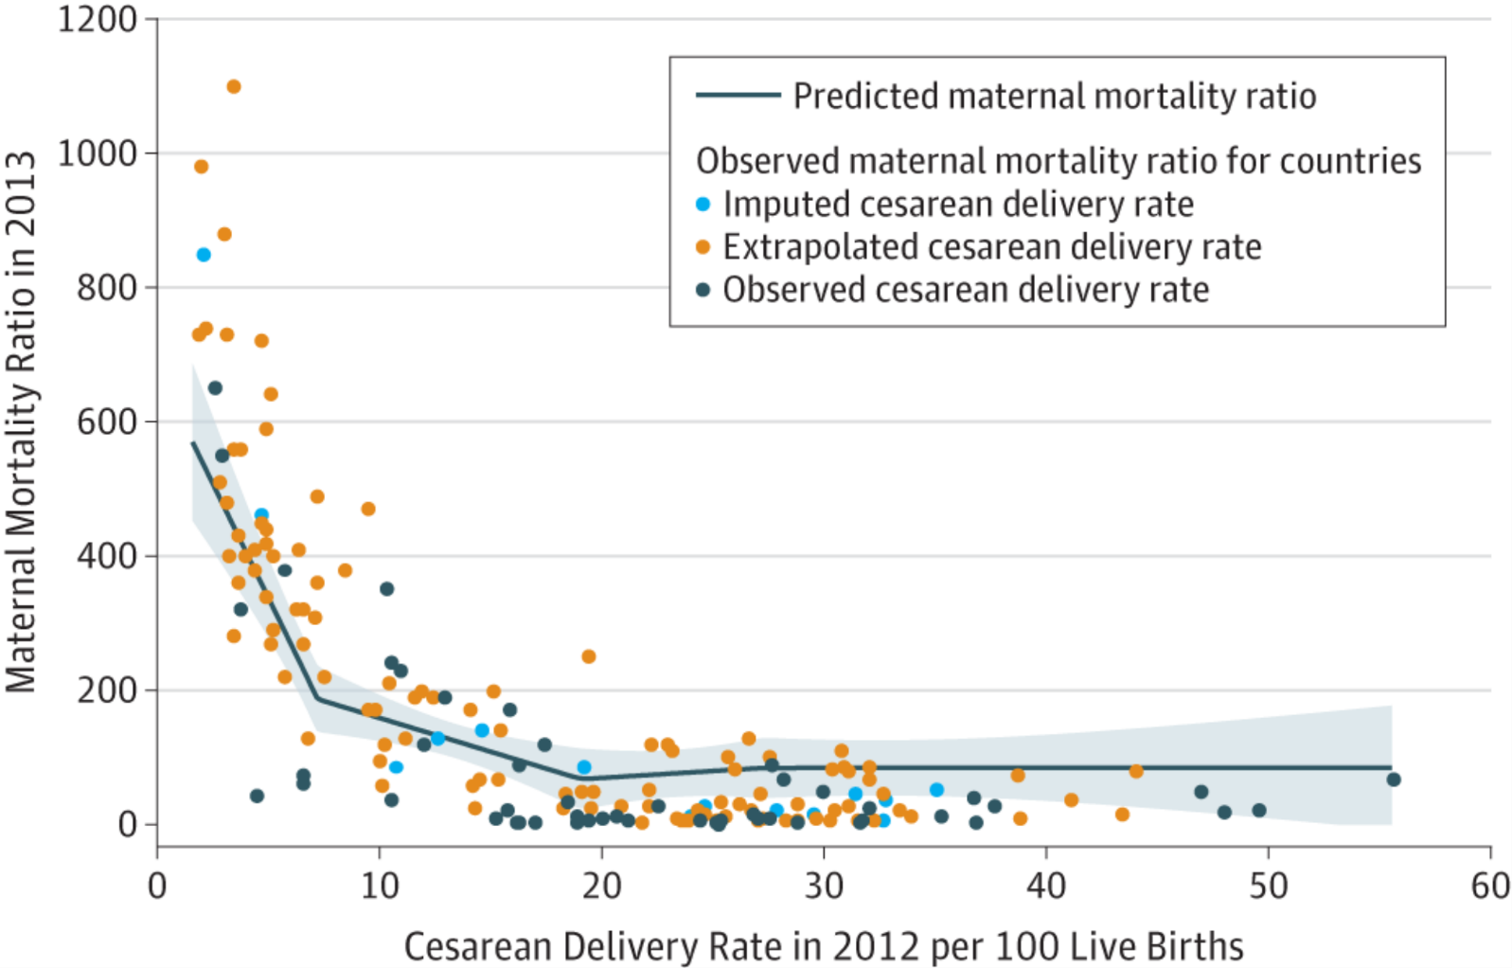
Is it because of high cesarean rate?
From: Relationship Between Cesarean Delivery Rate and Maternal and Neonatal Mortality
JAMA. 2015;314(21):2263-2270. doi:10.1001/jama.2015.15553
Copyright © 2016 American Medical Association. All rights reserved.

Slide 30
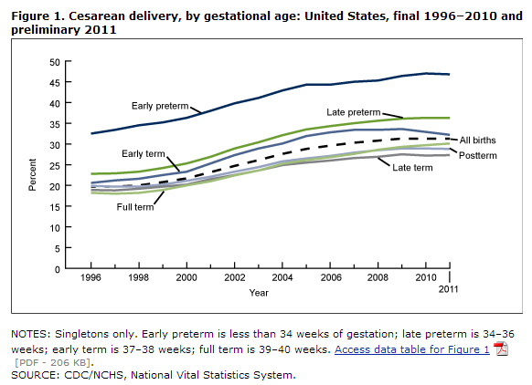
Is it because of high cesarean rate?
Probably not: While the cesarean rate in the USA is somewhat higher than Canada, it is similar to that in UK and lower than Australia.

Slide 31
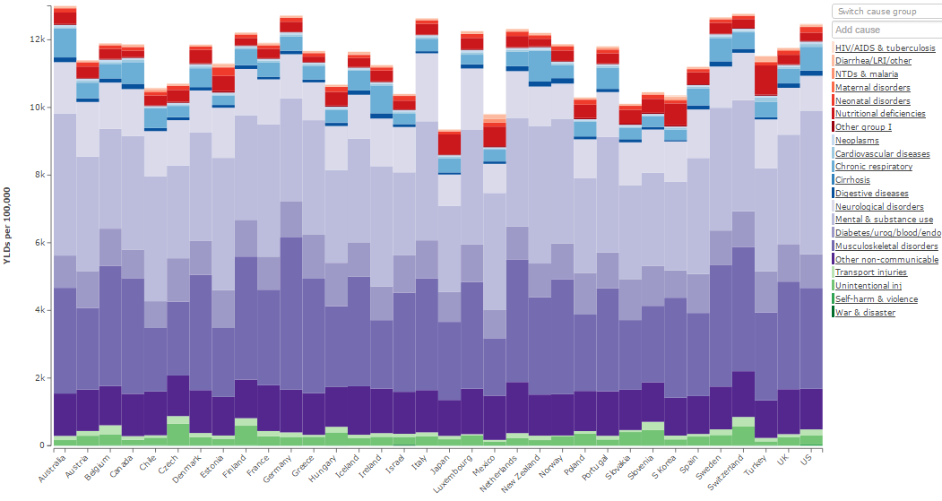
Is it because American women are sicker?
Unclear: The aggregate rate of non-communicable disease burden amongst American women ages 15-49 is amongst the highest of OECD countries.

Slide 32
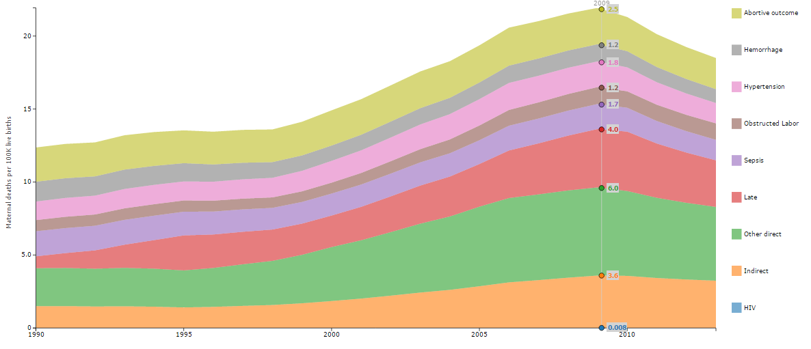
Is it because American women have more comorbidities?
It is possible: The number of deaths in the USA due to “standard” obstetric problems has not increased, but other direct, other indirect and late maternal deaths have increased substantially.

Slide 33
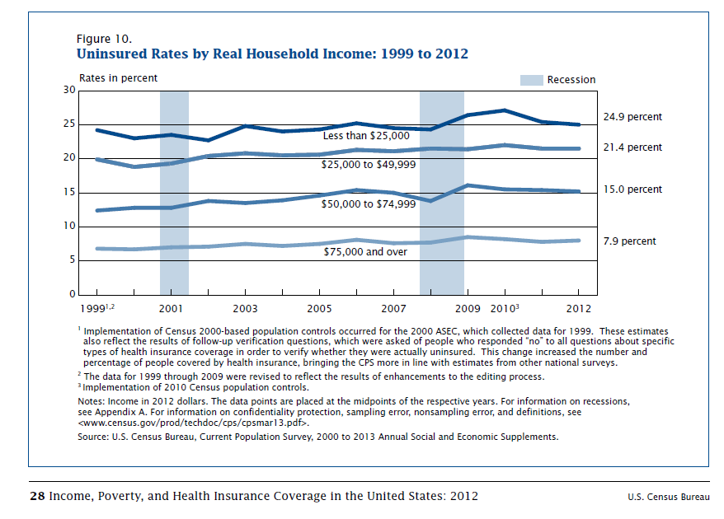
Is it because women have poorer access?
https://www.census.gov/prod/2013pubs/p60-245.pdf

Slide 34
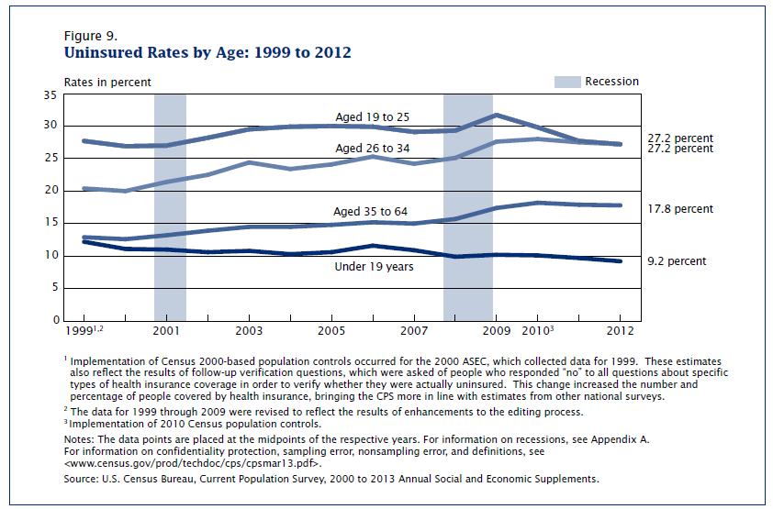
Is it because women have poorer access?
https://www.census.gov/prod/2013pubs/p60-245.pdf

Slide 35
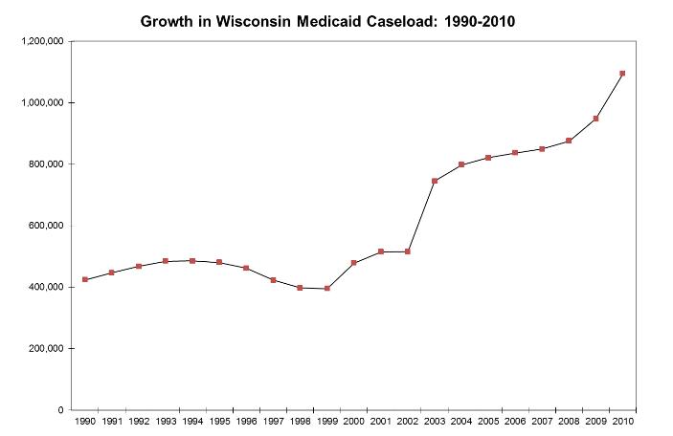
Is it because women have poorer access?
Possibly related: Increase in maternal mortality has paralleled increased rates of uninsured and under-insurance. Medicaid also does not cover pre-natal care as well as private insurers.
http://www.dhs.wisconsin.gov/mareform/

Slide 36
Recommendations for addressing high maternal mortality in USA
Perform state or county level analyses of maternal health outcomes to determine if pattern matches the known patterns of health inequity within the country or follows other patterns. (Underway in GBD 2015)
Analyze state-level Medicaid and private insurer data to determine if there are systematic differences in comorbidity and coverage for prenatal and peri-delivery care.
Conduct a "Confidential Enquiry" into all maternal deaths in the United States, modeled after similar programs in Australia and the United Kingdom. These programs and have yielded great insight into underlying causes and developed excellent guidelines for clinicians.
Be honest and upfront with patients who are contemplating embarking on high-risk pregnancies.

Slide 37
Outline
General themes of the Global Burden of Disease (GBD) project
Maternal mortality and progress toward Millennium Development Goal (MDG) 5
Maternal mortality in the United States
Child mortality in the United States

Slide 38
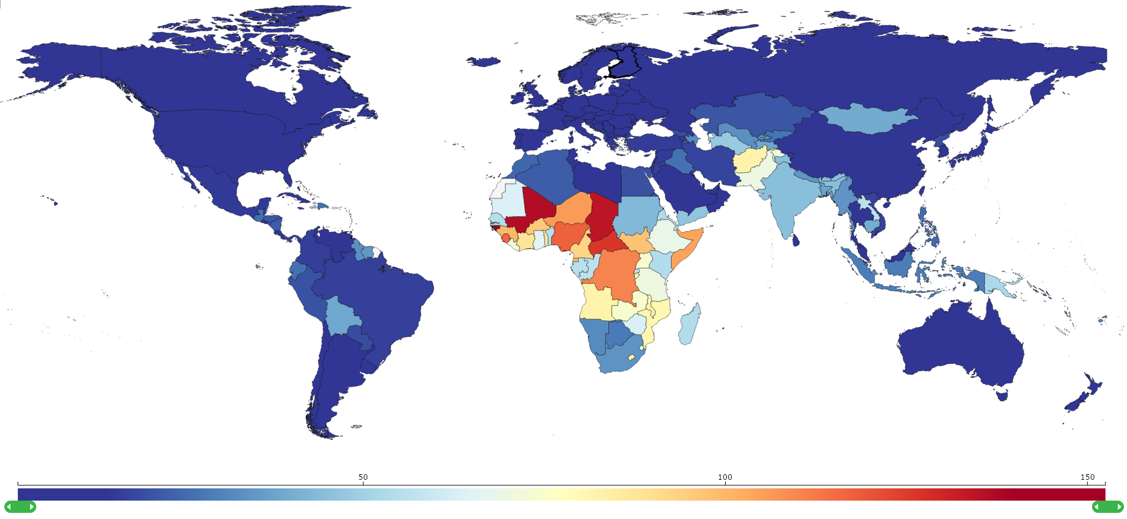
Child mortality globally and in the USA

Slide 39
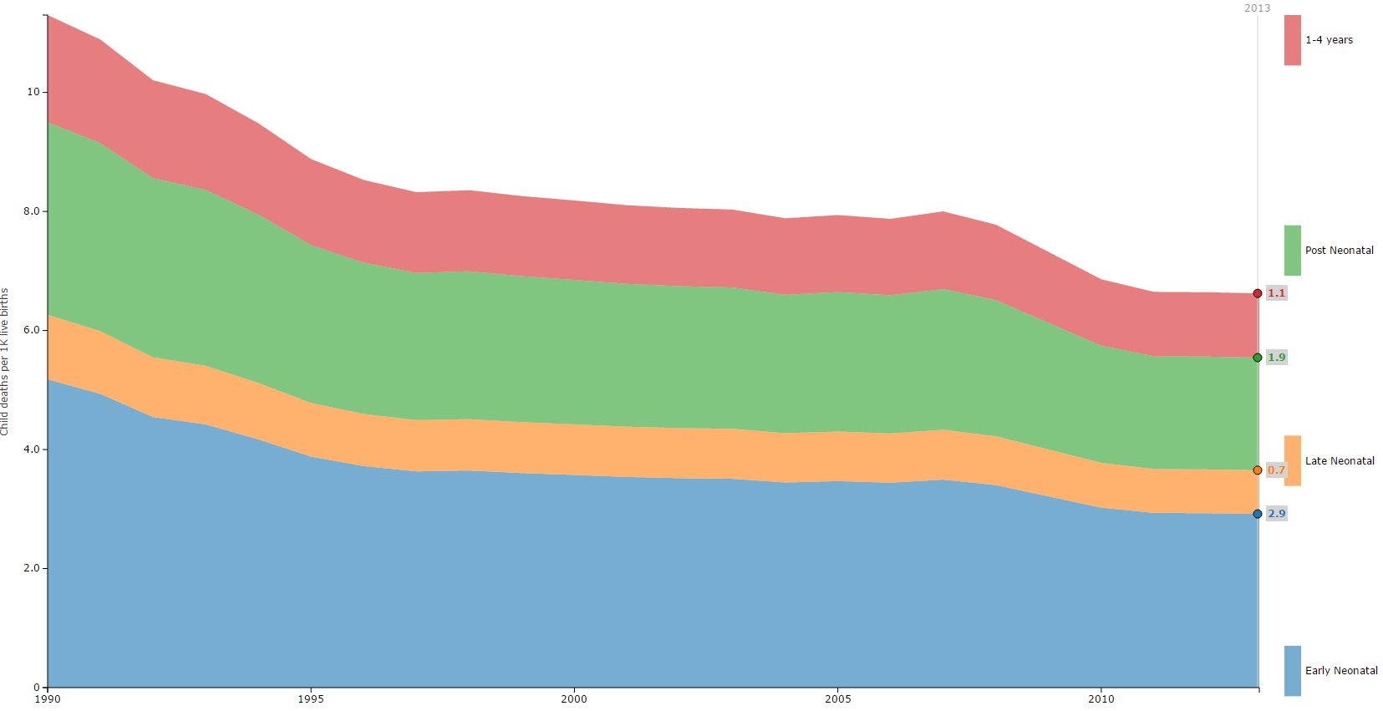
Child mortality rates in the USA, 1990 to 2013

Slide 40
USA has comparatively high child mortality

Slide 41
But it is not higher in all age groups: USA has higher newborn mortality, but lower in post-neonatal period and improvements have been slower than other countries

Slide 42
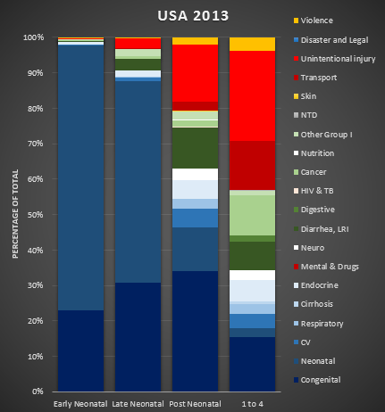
“Childhood” is not a single age group
The leading causes of death in each age group are very different.
ENN & LNN = congenital birth defects and neonatal conditions (e.g. prematurity)
PNN & 1-4 years = growing importance of cancer and injuries

Slide 43
Comparing death rates in <5 year-olds Higher rates of death due to injuries (especially unintentional injuries) and neonatal disorders drive higher child mortality in the USA

Slide 44
Congenital birth defects in USA have improved dramatically
The biggest drops were in congenital heart defects and neural tube defects.
Other congenital anomalies and Down syndrome have also decreased slightly.
Other chromosomal abnormalities have stayed unchanged.

Slide 45
Social determinants of health: USA has lagged

Slide 46
Recommendations for addressing high child mortality in USA
Perform state or county level analyses of child health outcomes to determine if pattern matches the known patterns of health inequity within the country or follows other patterns. (Underway in GBD 2015)
Analyze state-level Medicaid and private insurer data to determine if changes in health system access are associated with higher likelihood of mortality.
Encourage consolidation around a continuum of care model to reduce neonatal complications. Maternal and child health are closely interlinked, especially as family planning and maintaining healthy pregnancies can lead to reductions in both maternal mortality and perinatal mortality.
Focus on efforts to reduce injuries through counseling providers, maternal education, and improving safety policies.

Slide 47
www.healthdata.org Internet Keyword Search: “GBD Study”

Slide 48
Other helpful links
GBD Compare data visualization: http://vizhub.healthdata.org/gbd-compare/
Terms defined: http://www.healthdata.org/terms-defined

